Slide 1
Digital Portfolio
STUDENT NAME: HEMALATHA P
REGISTER NO AND NMID: 6832989924246A886974D59C0F1AFE9D
DEPARTMENT: B.SC.COMPUTER SCIENCE
COLLEGE: COLLEGE/ UNIVERSITY:GOVERNMENT ARTS COLLEGE UDUMALPET-642126/BHARATHIAR UNIVERSITY

Slide 2
PROJECT TITLE
INTERACTIVE DIGITAL PORTFOLIO USING FWD

Slide 3
AGENDA
Problem Statement​
Project Overview​
End Users​
Tools and Technologies​
Portfolio design and Layout​
Features and Functionality​
Results and Screenshots​
Conclusion​
Github Link​

Slide 4
PROBLEM STATEMENT
Students often face challenges in showcasing their skills, projects, and achievements in a professional way. A traditional resume is static and does not highlight creativity or technical ability. Hence, a digital portfolio is required to present personal and academic details effectively.

Slide 5
PROJECT OVERVIEW
This project is a Student Digital Portfolio Website that provides an interactive platform for presenting personal information, skills, academic details, and project work. The portfolio is responsive, user-friendly, and visually appealing.

Slide 6
WHO ARE THE END USERS ?
1.Students – to showcase their skills and projects.
2.Recruiters / Employers – to evaluate student profiles quickly.
3.Faculty Members – for academic evaluation.
4.Peers and Collaborators – to connect and collaborate on projects.

Slide 7

TOOLS AND TECHNIQUES
1.HTML5 – for structure and content
2.CSS3 – for design and layout
3.JavaScript (JS) – for interactivity and responsiveness
4.Visual Studio Code – as the development environment
5.GitHub – for version control and hosting

Slide 8
PORTFOLIO DESIGN AND LAYOUT
The portfolio is divided into multiple sections for clarity and navigation:
1.Home / Hero Section – Introduction with name, tagline, and call-to-action.
2. About Section – Personal details and background.
3.Projects Section – Showcasing academic and personal projects.
4.Contact Section – Email/contact information for collaboration.
5.Footer – Copyright and social media links.

Slide 9
FUTURES AND FUNCTIONALITY
✔️ Responsive navigation bar with mobile-friendly menu ✔️ Attractive hero section with personal intro
✔️ About section describing background & skills
✔️ Projects section with descriptions and links
✔️ Contact section with email integration
✔️ Responsive design for desktop and mobile devices

Slide 10

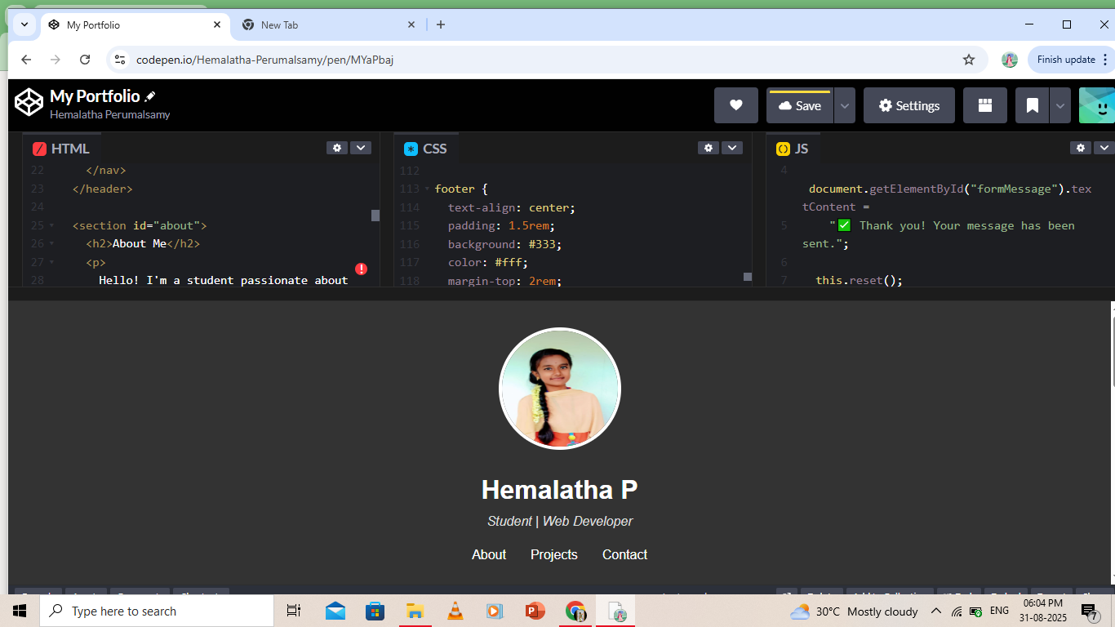
RESULTS AND SCREENSHOTS
Successfully designed a responsive digital portfolio.
Website loads smoothly on both desktop and mobile devices.

Slide 11
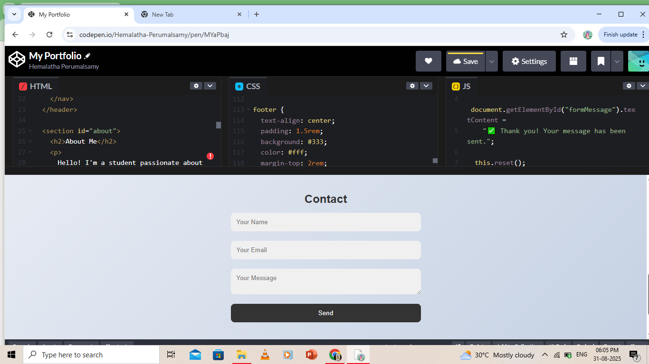
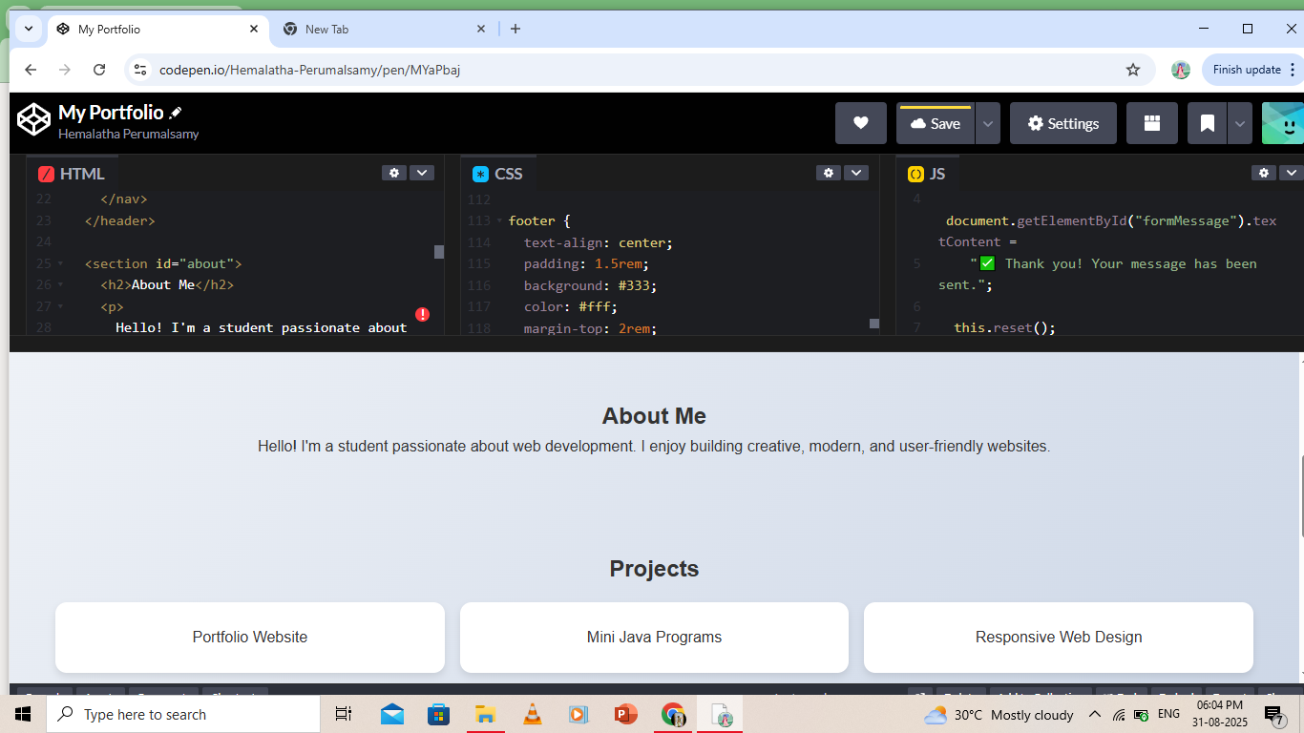
Enhanced personal branding through clean design and layout. (Screenshots of each section can be added here)

Slide 12
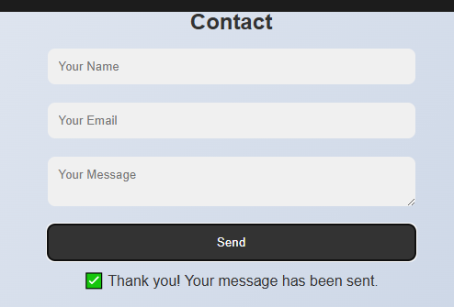

Final Result Of The Program

Slide 13
CONCLUSION
The Student Portfolio website provides a professional and creative way to present skills, projects, and achievements. It demonstrates the importance of having an online identity and acts as a stepping stone for career opportunities.

